Slide 1
CST8333 Assignment 1
Space guy: Blockade – arcade style space shooter
Andrew Gaal
February 10, 2022

Slide 2
Table of Contents
Introduction
Details
Timeline and Budget
Source Code Implementation
Testing
Deployment
Conclusion
Contact

Slide 3
Introduction
Accomplishments
Source Code Implementation Completed
Testing completed with no outstanding failures
Application satisfies all requirements outlined in initiation phase
Application packaged for deployment
All deliverables completed, submitted and approved
Opportunities for Refinement
Additional gameplay features and quality of life improvements documented for future development
Game could be rebuilt in a dedicated game engine

Slide 4
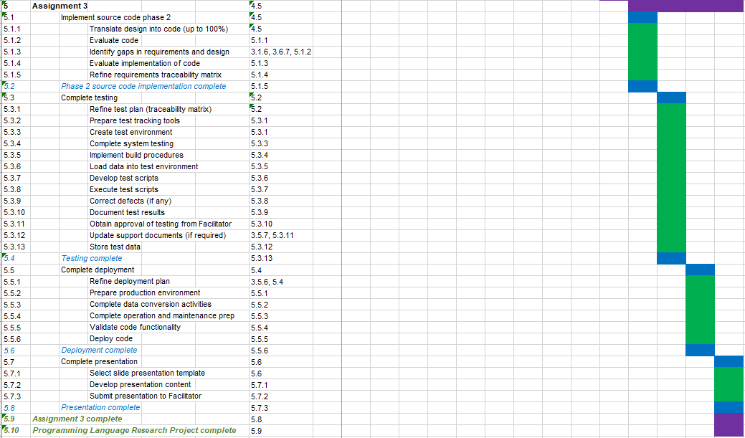
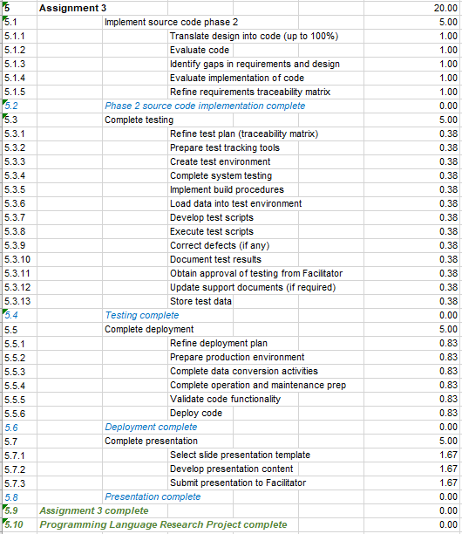
Details – Timeline & Budget
Timeline
The project has been completed on time and on schedule. This phase of development proceeded far more smoothly than the last and time lost to schedule slippage has been made up for.
Budget
The budget is based on level of effort rather than financial input. Thus far, budget estimates have been accurate.

Slide 5
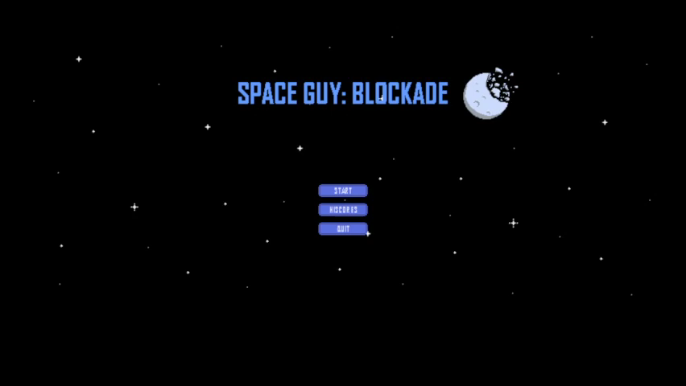
Details – Source Code Implementation
Programming Language: Python
Python was selected for the development of this project due to it’s popularity with employers and it’s extensive community support. Since I was largely unfamiliar with the language at the beginning of this project, it also served to provide the greatest opportunity for learning and personal growth.
Since the last presentation, the remaining 40% of the source code has been implemented. The video to the right displays the new features (audio muted).

Slide 6
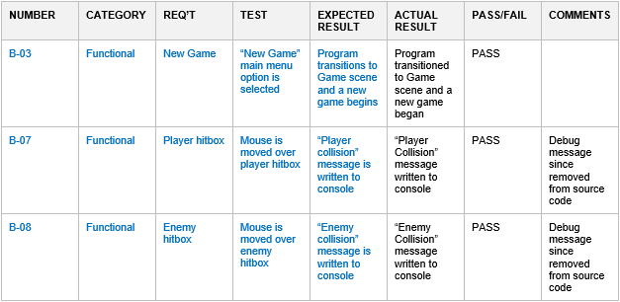
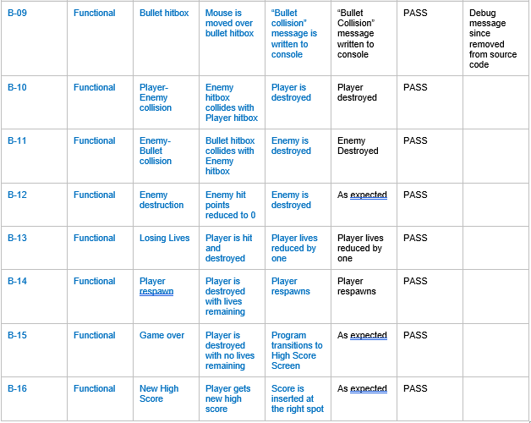
Details – Testing
Method
Write source code for new feature
Run program
Check result against table
If it passes, continue to next feature
If it fails, or breaks something else, debug source code and test again

Slide 7
Details – Deployment
Since Python is a scripting language, additional tools were required to package the software into an executable file. PyInstaller was used for this purpose. The game files can now be packaged as a zip file and distributed online. A copy of this zip file has been included with this assignment for demonstration purposes.

Slide 8
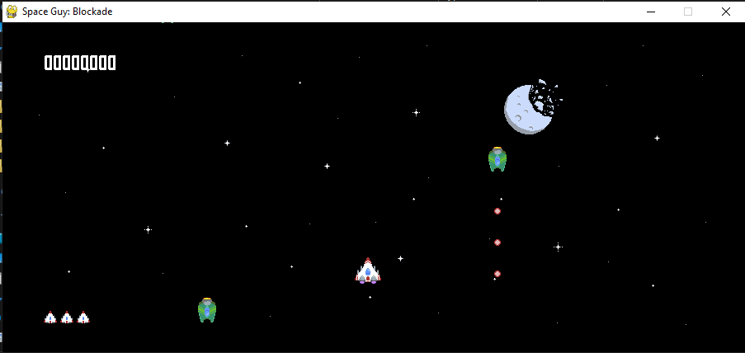
Conclusion
Phase 3, Project Deployment, is now complete.
100% of the source code is now implemented and the project is ready for deployment.
The testing phase proved that the requirements set out in the design phase have been implemented correctly.
Next steps include further refinement of gameplay and graphics, possibly on another development platform.

Slide 9
Contact
Andrew Gaal
SID#040816319
gaal0007@algonquinlive.com

